Slide 1

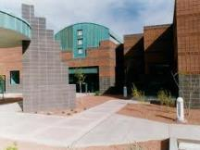
Designing a Sustainable Masonry Cavity Wall Building Envelope

Slide 2

Copyrighted Material
This presentation is protected by US and International copyright law. Reproduction, distribution, display and use of the presentation without written permission of Mortar Net® Solutions is prohibited.
©2012 Mortar Net® Solutions

Slide 3

AIA CEU Program
Mortar Net® Solutions is a Registered Provider with The American Institute of Architects Continuing Education Systems. Credit earned on completion of this program will be reported to CES Records for AIA members. Certificates of Completion for non-AIA members available on request.
This program is registered with the AIA/CES for continuing professional education. As such, it does not include content that may be deemed or construed to be an approval or endorsement by the AIA of any material of construction or any method or manner of handling, using, distributing, or dealing in any material
or product. Questions related to specific materials,
methods, and services will be addressed at the
conclusion of this presentation.

Slide 4
Purpose and Learning Objectives
At the end of this course, participants will be able to:
Define the characteristics of sustainable design as defined by the AIA
Define the characteristics of a sustainable masonry cavity wall building envelope
Explain and avoid poor masonry cavity wall envelope design and detailing
Define and specify appropriate materials for sustainable masonry cavity walls

Slide 5


Sustainable Design
AIA Definition
Incorporate resource-efficient construction and use processes
Create minimal environmental impact
Reduce or eliminate waste, pollution and environmental degradation
Protect occupant health and improve occupant productivity
Notes:
A building that meets AIA’s criteria for “Sustainable Design” must meet all four of the following requirements.
Incorporate resource-efficient construction and use processes
Create minimal environmental impact
Reduce or eliminate waste, pollution and environmental degradation
Protect occupant health and improve occupant productivity
The degree to which a building and its design meet these four requirements determines their level of sustainability. Sustainable design will produce buildings that can withstand environmental impact and high use, provide prolonged utility and value, and endure for a very long time.

Slide 6
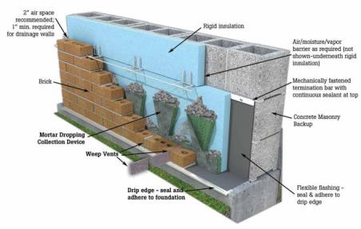
Sustainable Masonry Cavity Wall
Design Characteristics
Integrated moisture management system
Water infiltration is confined to the cavity
High quality connection between veneer and structural walls
Controlled air infiltration in/out of cavity & building
Notes:
Most modern masonry building envelopes use a cavity wall design. This image shows a typical masonry cavity wall with a CMU structural wall and rigid insulation. Light commercial buildings and homes may use steel studs and sheathing for structural walls instead of CMUs, but the basic components of a well designed masonry cavity wall are the same - a structural wall, a masonry veneer, a cavity in between the two, and a moisture management system.
However, not all masonry cavity walls meet the AIA’s definition of sustainability. A sustainable cavity wall will have these characteristics.
An integrated moisture management system that provides rapid and thorough water drainage out of the cavity, including around wall openings, corners, and points at which different building materials meet.
The ability to confine water infiltration to the cavity between the inner and outer wythes.
A high quality connection between the masonry veneer and the structural wall that prevents the veneer from sagging or pulling away.
Controlled air infiltration into and out of the cavity that allows the wall to dry properly but which creates minimal air infiltration into the building.
Throughout the course we will review the various components and methodologies that support sustainable masonry cavity wall design, beginning with a discussion of why masonry is the ideal sustainable building material.

Slide 7
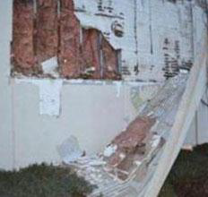
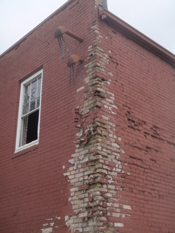
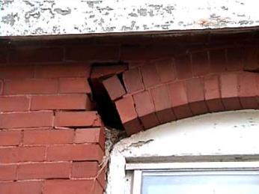
Wall Failure
Causes and Examples
Notes:
Water infiltration is the #1 cause of masonry wall failure, and preventing it through proper design and detailing can make or break the quality and sustainability of a masonry building, especially a masonry cavity wall envelope. The buildings you see here aren’t all masonry cavity wall construction, but they graphically illustrate how extreme water damage can be. In the next few slides we’ll look at some examples of small details that can make the difference between a sustainable, durable building and one that has problems.

Slide 8
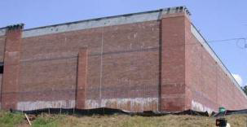
Wall Failures
Efflorescence
1 Year-Old Store
Notes:
The line of efflorescence at the bottom of this wall is at the interior floor level. It shows that water had difficulty exiting the cavity, so it forced its way out through the mortar to the exterior and leached minerals from the mortar onto the face of the building. The weight of water in the cavity also forced water into the building interior, requiring extensive repair and rendering the store unsanitary and unusable until repairs were completed.

Slide 9
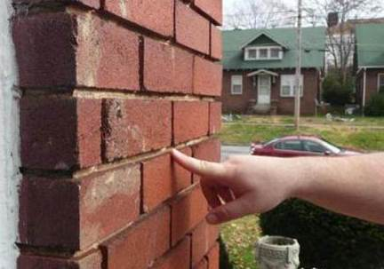
Wall Failures
Raked Joints
Poor seal with brick surface
Opens voids in head and bed joints
Creates ledges that can hold water
Ledges
Notes:
Raked joints can cause spalling and efflorescence. In raked joints, the mortar is struck so that its face is flat rather than rounded, and it’s held back from the brick face by ¼″ to ½ ″. This design provides a poor seal with the brick surface so water can penetrate the joints, allowing freeze/thaw cycles to break up the brick and destroy mortar bonds. Raked joints also create ledges that can hold water, which gives water another chance to seep through the mortar and cause efflorescence, as well as providing even more opportunities for infiltration.

Slide 10
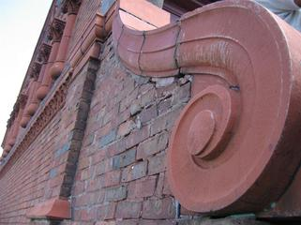
Wall Failures
Cracks
Allows water into the building
May be due to
  Wrong mortar mix
  Foundation failure
  Bad wall details
Cracks from water infiltration
Notes:
The cracks in this wall are due to water damage from water infiltration. After a few freeze/thaw cycles, the wall will deteriorate further. When water infiltration occurs, you might also find that the brick ties corrode and allow the veneer to pull away from the structural wall, and that water may penetrate the interior walls.

Slide 11
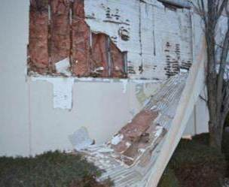
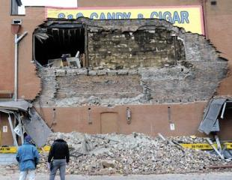
Wall Failures
Poor Detailing
Water saturated EIFS
Unsealed coping at wall top
Lack of drainage at wall bottom
Easily preventable with proper design and workmanship
Rusting metal studs
Mold
Wall collapse from water infiltration
Notes:
Here’s 2 more examples of the disastrous effects of poor detailing. The picture on top is an Exterior Insulated Finish System, or EIFS wall. While it’s not a masonry cavity wall, we’re including it to show that poor detailing can allow water behind a building’s facade and destroy it from the inside out. This wall failed because of undetected water infiltration caused by unsealed coping at the top of the wall and lack of drainage at the wall bottom, circumstances that can also occur in masonry cavity walls. The severe damage in this wall was not obvious until large sections of it suddenly peeled off the structural wall to reveal extensive corrosion and mold. In masonry cavity walls with this kind of hidden water infiltration, large sections of the brick façade may suddenly collapse. In the lower picture, you can see how a huge section of the brick façade of a building in Pittsburgh peeled off. The collapse happened in a matter of seconds.

Slide 12
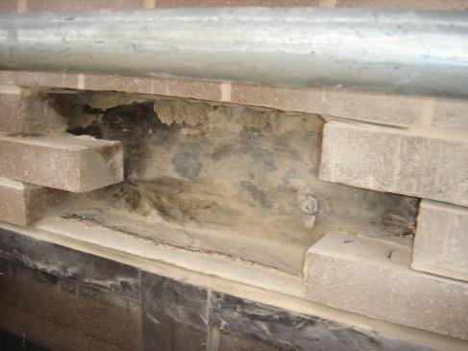
Wall Failures
Poor Flashing Installation
Flashing held back
No metal drip edge
Flashing failure in 2 year old hospital
Notes:
This is a textbook example of a poor flashing installation. The flashing was held too far back from the brick face and there is no metal drip edge, which allowed water infiltration at the brick ledge.

Slide 13
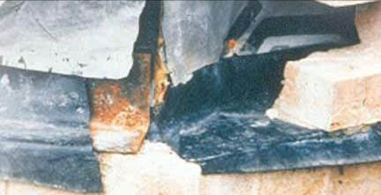
Wall Failures
Poor Flashing Installation
Rusting structural steel
Flashing does not seal corner
Notes:
Leaks frequently occur at corners, both because they're an area where three different building planes meet and because proper installation of multiple flashing components is required for a watertight seal.
The damage shown in this photo demonstrates how important excellent corner flashing is. One-piece corner boots are the best choice for both outside and inside corner flashing because they simplify installation and make it easier to create a watertight seal with the horizontal flashing. For the same reasons, one-piece end dams are the best choice for creating watertight joints over wall openings, another area prone to leaks.

Slide 14
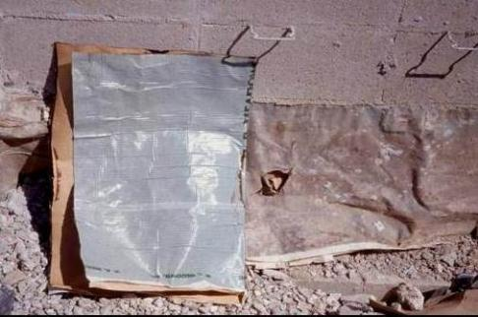
Wall Failures
UV-Damaged Flashing
UV exposure results in curling, shrinkage
New flashing
New VS. UV-damaged flashing
Notes:
Failure to protect UV-sensitive membranes on the job site guarantees flashing failure. UV-damaged flashing must be replaced, which costs much more than protecting the original flashing. In this example, the peel and stick flashing was likely installed long before the masons were ready to lay the brick veneer and the UV exposure destroyed it. Deterioration will happen much more rapidly at high altitude or in desert climates.
If a project shuts down for a while when the flashing is exposed, it must be re-evaluated before the brick can be installed. If the shut down is owner-directed, it becomes the owner's responsibility to replace UV-damaged flashing.

Slide 15
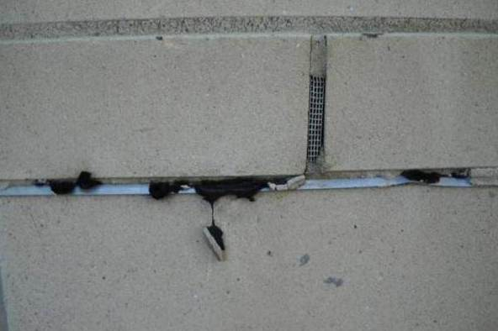
Wall Failures
Rubberized Asphalt Flashing “Drool”
Partially obstructed corrugated weep vent
Liquefied RA membrane “drools” down the building face
Notes:
“Drool” occurs when a UV- or heat-sensitive membrane such as rubberized asphalt is installed too close to the front edge of the brick. The sunlight and heat from the wall liquefies the membrane and ruins the wall’s appearance. “Drooling” also compromises the effectiveness of the flashing by creating openings between the brick and the flashing.
As mentioned earlier, trying to solve this problem by holding the membrane back from the edge of the brick creates opportunities for leaks. If you specify a UV-sensitive membrane, then the best solution to this problem is a metal drip edge. Another alternative is to use a membrane that is not UV or heat sensitive.

Slide 16

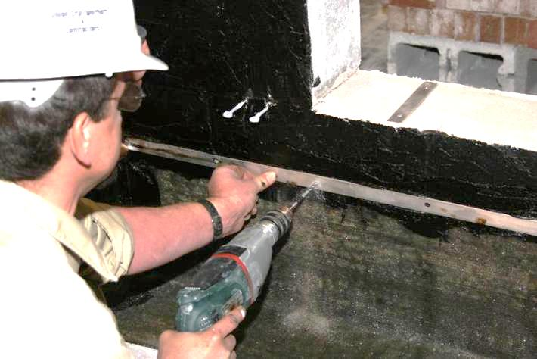
Wall Failures
No Termination Bar
Flashing failure – no termination bar
Spec termination bars for all flashing, including peel & stick
Notes:
Termination bars seal the top of a flashing membrane against the structural wall. They prevent the membrane from peeling away, and force water that runs down the structural wall to flow onto the surface of the flashing where it can exit the cavity. It is crucial to specify termination bars with all flashing membranes, even peel and stick, and to specify a bead of sealant along the top of the bar.

Slide 17
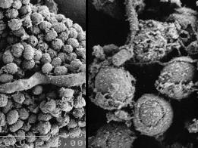
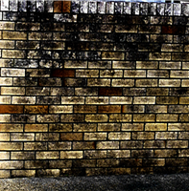
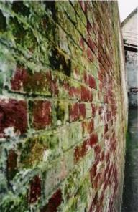
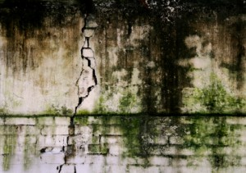
Wall Failures
Mold
Mold spores
4 types of destructive mold :
Black Mold – grows on any organic substance
Penicillium – grows on building materials
Cladosporium – produces VOCs
Aspergillus – AKA Mildew
Mold-damaged brick
Notes:
Mold grows on organic substances like wood, paper, carpet, insulation, and drywall, and it needs moisture to survive, so leaks can create the perfect environment for it. It is extremely hardy, and can grow unchecked and sometimes unnoticed, eventually destroying a building’s interior and any organic components of the building envelope. There are hundreds of varieties of mold, but only four types of destructive mold are common to buildings.
•Black Mold – grows on any organic substance
•Penicillium – grows on common building materials
•Cladosporium – produces VOCs which can smell bad and be harmful to building occupants
•Aspergillus – also known as mildew, may be highly toxic to humans and animals, and can create severe health hazards
Masonry is an excellent building material for preventing mold, but it is still susceptible if it is constantly wet. Just another reason to make sure you have a proper drainage system.

Slide 18
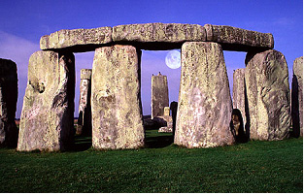

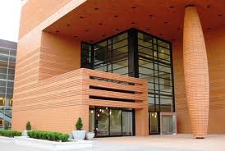
Masonry: The Ideal Sustainable Building Material
Notes:
Now let’s look at why masonry is the ideal sustainable building material.

Slide 19
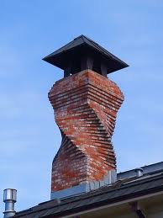
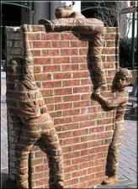
Design Flexibility
Spiral Chimney
Brick Sculpture
Bechtler Museum, Charlotte, NC
Notes:
Both form and function are important to designers, architects, building owners and users; masonry provides ultimate versatility in both artistic expression and building function.

Slide 20
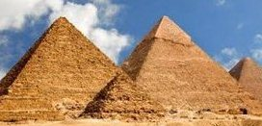
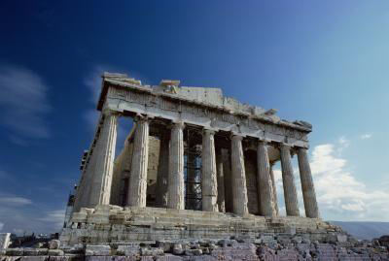
Durability
Pyramids of Giza, Cairo, Egypt Age: Approx. 4,500 Years
The Parthenon, Athens, Greece
Age: Approx. 2,400 Years
Notes:
Masonry is extraordinarily durable as exemplified by the ancient masonry buildings still standing today. While both these examples show extensive wear, keep in mind that, in spite of being built using what we would consider to be extremely primitive materials and techniques, they’ve endured for millennia.

Slide 21
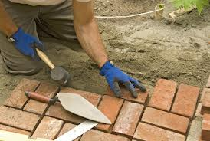

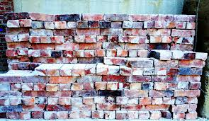
Recyclability and Reusability
Masonry buildings can be renovated to serve new purposes
Bricks can be salvaged, cleaned and reused
Sources: Think Bricks www.thinkbrick.com.au/why-are-bricks-sustainable-4/
"The Sustainable Attributes of Exterior Cladding Materials", The Brick Industry Association, http://www.gobrick.com/Portals/25/docs/Sustainability/Green%20Sheets%20-%20Precast%20Concrete%20-%20Generic.pdf
Notes:
Masonry is recyclable and reusable.
Masonry buildings are extremely durable, so they can often be renovated to serve new purposes, eliminating both the need to construct new buildings and all of the associated environmental impact of razing an old structure and building a new one.
Bricks can be salvaged, cleaned and reused to construct building remodels or additions where the brick has to match the original structure, and as landscaping accents or pavers.

Slide 22
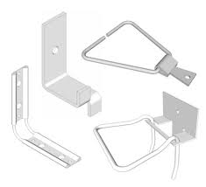
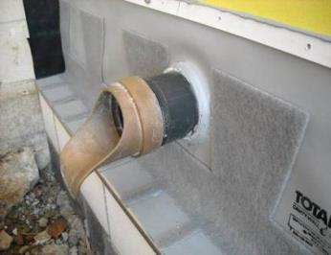
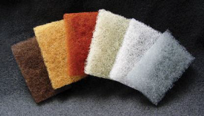
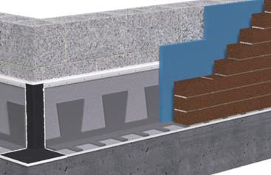
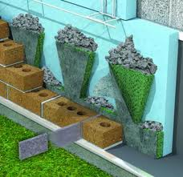
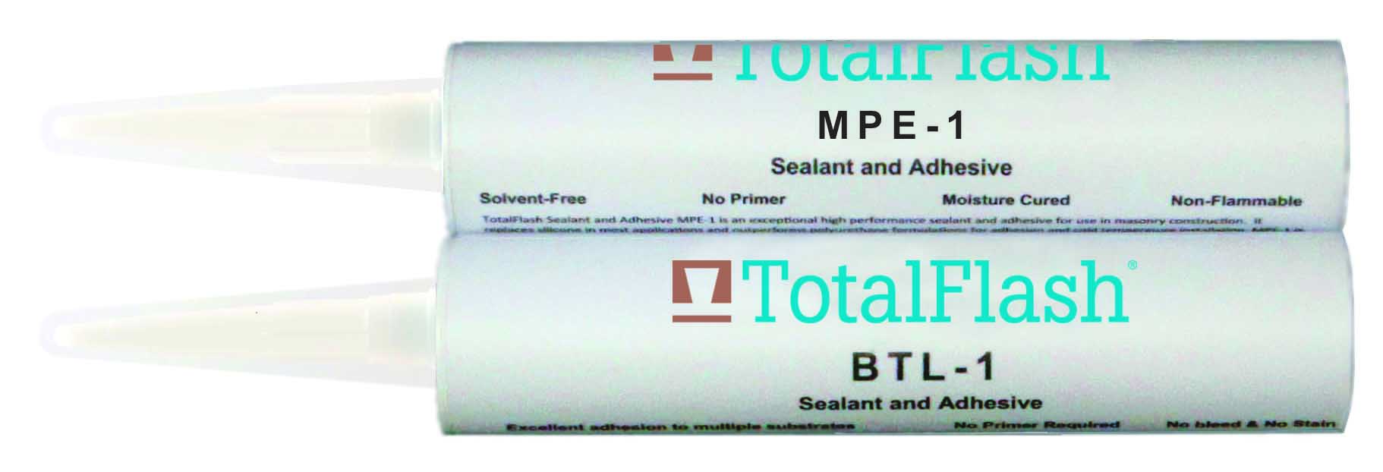
Masonry Cavity Wall Components
Notes:
Now let’s look at the components of a sustainable masonry cavity wall, starting with wall ties.

Slide 23
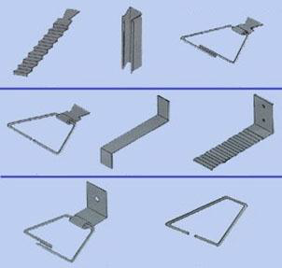
Wall Ties Defined
Tie the structural wall to the masonry veneer
Prevent the veneer from bulging, sagging or pulling away
Are non-corroding, high-strength metal
Typical Wall Ties
Correct tie size and design must be specified or wall can fail
Notes:
Wall ties, also known as wall anchors, span the cavity between the structural wall and masonry veneer and tie the two together. They prevent the veneer from bulging, sagging or pulling away from the structural wall. The correct tie size and design must be specified or the wall can fail, sometimes quickly and dramatically. Wall ties are typically made from a non-corroding, high-strength metal such as stainless or galvanized steel.

Slide 24
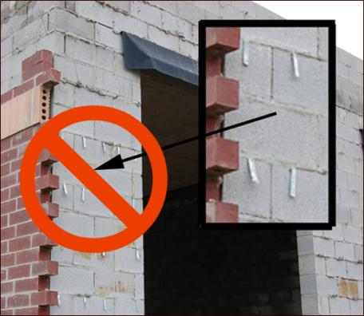
Lightweight Corrugated
Wall Ties
Do not use in commercial construction
Notes:
This is an example of an unsustainable, improper, and potentially dangerous design. These lightweight corrugated ties in a commercial building increasing the likelihood of cracks in the veneer and make it possible for the veneer to pull away from the structural wall. Be sure to specify commercial grade anchors that are best suited to the application. If you specify generic or “or equal” wall ties, lighter ties may be used to reduce build costs.

Slide 25
Commercial Wall Ties
Typical
Notes:
Ties used in commercial construction are much heavier than residential ties. They are available in a wide variety of shapes, sizes and configurations so they can be matched to the structural wall type, the veneer type, and the cavity width, as well as to the site and environmental factors.

Slide 26
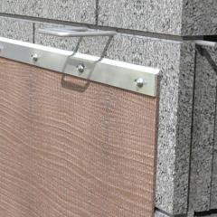
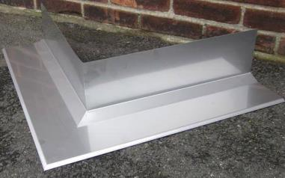
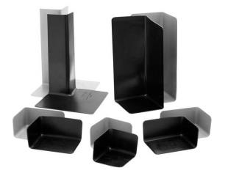
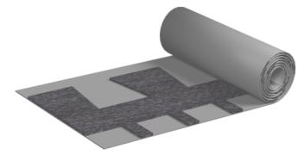
Flashing
Notes:
Now let’s talk about how flashing is used in sustainable design. Flashing includes horizontal runs, corners and end dams.

Slide 27

Flashing Sustainability Considerations
Stainless Steel
Superior durability
100 % recyclable
High energy cost
Highly skilled labor
Notes:
Stainless steel will last virtually forever. It’s 100 % recyclable, but it takes a lot of energy to make it, more energy to fabricate it in a factory, and even more energy in welding materials and transportation costs to install it on-site. It also requires highly skilled fabricators and installers.

Slide 28
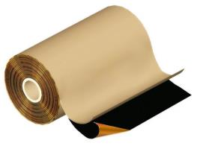
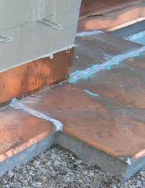
Flashing Sustainability Considerations
Laminated & Cold Rolled Copper
Superior durability
100% recyclable (copper & lead components only)
High material & labor costs (cold rolled)
Highly toxic production
Notes:
Copper products, including laminated copper and cold-rolled, will also last practically forever. Copper and lead, which you’ll find in cold-rolled copper installations, are 100% recyclable, but the other materials commonly used in copper laminate, such as asphalt and fiberglass, are not recyclable. Production and installation costs are lower than stainless steel, although in the case of cold rolled copper, they’re still high, while the costs of installing copper laminated products can be much lower. Energy and toxic chemical use in the mining and creation of copper and lead is high, so they have a high environmental impact.

Slide 29
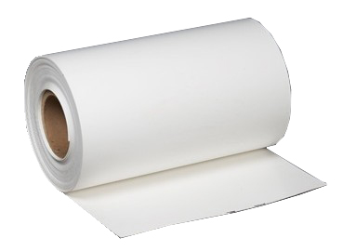
Flashing Sustainability Considerations
Thermoplastic Polyolefin - TPO
Durable
Lower material & labor costs
Chlorine-free
100% recyclable
Notes:
Accelerated weather testing (EG: ASTM D4434) of EPDM, TPO and other roofing materials has shown that these membranes are very durable and will not deteriorate when properly installed as in-wall flashing. Production and installation costs are lower than stainless and copper products, TPO is made without chlorine so is considered to be a “green” product, and most TPO membranes are recyclable.

Slide 30
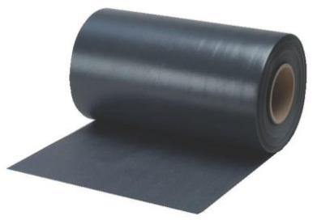
Flashing Sustainability Considerations Thermoplastic Vinyl
Should include non-migratory plasticizers
Lower material & labor costs
Recyclable
Petroleum & Chlorine content
Notes:
Modern thermoplastic vinyl flashing and components, such as corner boots and end dams, are very durable thanks to the addition of non-migratory plasticizers. Thermoplastic vinyl has been used in roofing applications for many years with great success and will last through multiple building life cycles. It costs roughly the same as TPO and EPDM and is recyclable, but it contains petroleum and chlorine, which are toxic chemicals.

Slide 31
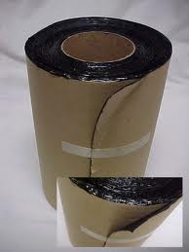
Flashing Sustainability Considerations
Rubberized Asphalt
Least expensive
Relatively low energy costs to manufacture and install
Petroleum-based
Not recyclable
Notes:
Rubberized asphalt is the least expensive flashing material in common use and is usually sold in "peel and stick" form, with an adhesive-coated back protected by removable paper. Its manufacturing and installation costs are relatively low. Rubberized asphalt is petroleum-based, is not recyclable and will remain intact in a landfill for decades.

Slide 32
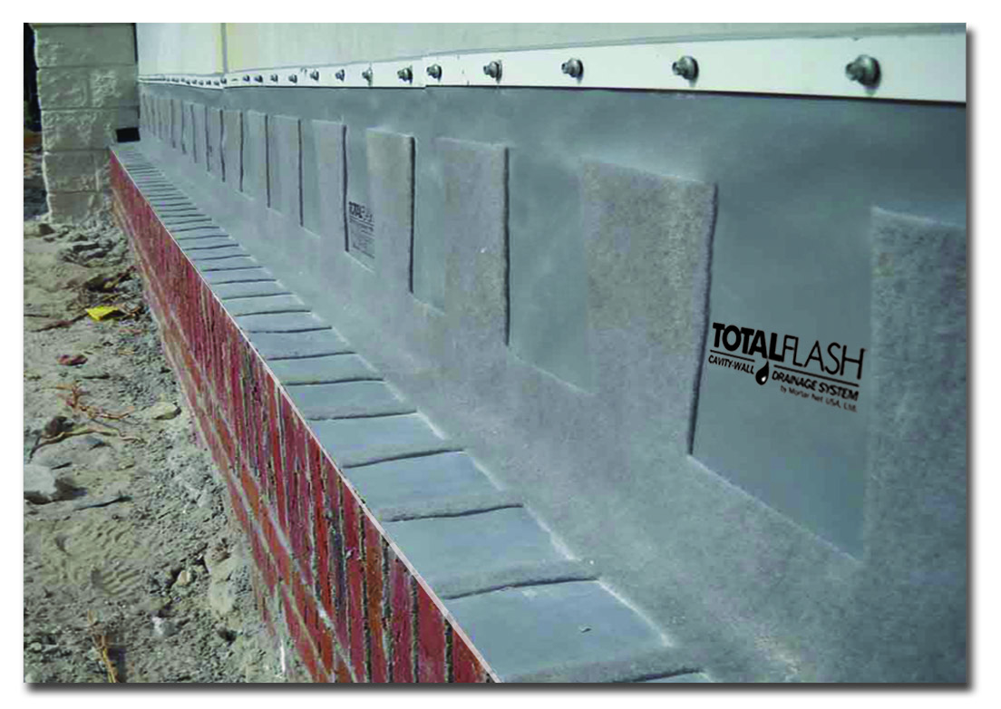
Flashing Sustainability Considerations Unitized Flashing System
Variety of membranes
Extremely durable
Minimizes the “Human Element”
Helps keep projects on time
Many components are recyclable
Notes:
Unitized flashing systems are available with a variety of highly durable membranes and can be manufactured to meet a wide range of use and climate conditions. They are competitively priced, are easy to install without special skills or tools. They are designed to minimize the “human element” - that is, they are factory assembled so they are far more consistent in quality than field assembled flashing systems, and they minimize the number of opportunities for installation errors, both of which help reduce the chances of leaks. They are also designed to dramatically reduce installation time as compared to installing individual components so they help keep the job running on time.
They can be manufactured in custom sizes and lengths, which can also reduce installation times, especially over wall openings and in rehab projects. Many components, such as stainless steel drip edges and termination bars, and copper drip edges and membranes, are 100% recyclable.

Slide 33
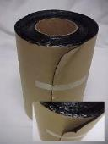
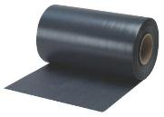

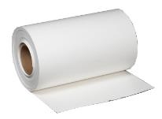
Flashing Specs Should Be Based On:
Building life
Budget
Climate
Installer skill
Notes:
With the wide variety of flashings available, the flashing you specify as part of a sustainable envelope must be chosen according to the expected building life, the project budget, climate conditions, and the skill level of the installation technicians.
It is important to note that the three biggest flashing installation mistakes are failure to install a termination bar, which can allow the membrane to peel away from the substrate, corner details that are improperly fabricated in the field, and holding the membrane back from the face of the wall, which eliminates the flashing’s through-wall performance characteristics and allows water to penetrate the brick face. Note that the manufacturer’s warranty will be conditional on proper installation.
It's also vital that you specify corner boots and end dams that are compatible with the specified membrane and the sealants used to seal them together, particularly with TPO and thermoplastic vinyl components. One-piece corner boots and end dams produce the best corner detail. They are much faster to install and are less likely to leak than so-called “origami” corner boot designs, which use multiple sections of membrane and rely heavily on the skill of the mason to ensure they’re watertight.
Finally, a primer may be required with the sealants and with some peel and stick membranes, depending on the manufacturer’s recommendation.

Slide 34
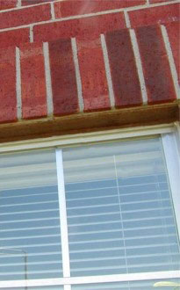
Detailing =
Success or Failure
No flashing or weeps = lintel damage
No flashing = masonry damage
Notes:
Like wall ties, flashing is a relatively small component of a masonry building envelope, but proper specification and installation is vital to the effectiveness and longevity of the envelope. Proper detailing around wall openings, the roof/wall interface, decorative details and wall penetrations is especially important. These pictures are examples of how a lack of flashing can cause extensive and expensive damage. The lintel in the picture on the left is heavily rusted due to a lack of flashing and weeps that allowed water to build up behind the brick soldier course over the window. As the rust expands, it will move and possibly crack the bricks. In the picture on the right, water damage to the brick under the decorative coping has pushed the bricks out and caused mortar degradation.

Slide 35

Proper Flashing Detail
Penetration through a unitized drainage solution flashing
Sealant bead – continuous
Notes:
This is an example of proper detailing around a pipe through a unitized drainage solution flashing. This type of detail is appropriate for any type of commonly-used flashing, and it illustrates how specific details must be to be effective and long-lasting. Note how the flashing fits tightly around the pipe and how a heavy bead of sealant runs continuously around the pipe to seal the flashing to the pipe. During installation, a heavy bead of sealant was also placed around the pipe immediately before the flashing was installed, so the pipe is sealed on both sides of the membrane.
Next let’s look at cavity wall moisture drainage systems.

Slide 36
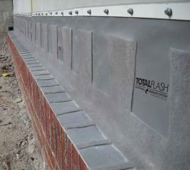
Cavity Wall Drainage System Defined
A combination of components that allows moisture to drain from a masonry cavity wall
Flashing
Mortar collection device
Drip edge
Weep vent
Corner boot
End dam
Notes:
A drainage system is a combination of components that allows moisture to drain from the wall.

Slide 37


Drainage System Benefits
Allows moisture to rapidly exit the cavity
Extends building life/beauty
Prevents:
  Structural damage
  Conditions that foster mold growth
  Water from entering building interior
  Efflorescence & other stains
Notes:
Properly designed drainage systems:
Allow moisture to rapidly pass out of the cavity and helps cavity dry quickly
Help prevent moisture condensation on building structural components to prevent corrosion
Help prevent mold growth to help keep building occupants healthy
Help prevent interior damage by keeping water out of the interior
Help stop efflorescence/spalling and other stains to preserve the building’s appearance
Extend building life for greater ROI for the building owner

Slide 38


Drainage System Examples
Mortar Droppings
No Mortar Collection Device
Pea Gravel
Notes:
These are examples of systems that are not uncommon but which don’t work. They include flashing, a drip edge, and other components of a good drainage system, except for one thing – they either lack a mortar dropping collection device, as in the picture on the left, or they have an ineffective one, as in the picture on the right. Note how having no mortar dropping collection device allows mortar droppings to pile up on the flashing and block weep vents. Pea gravel simply raises the mortar dam but doesn’t eliminate it.

Slide 39


Drainage System Examples
Mortar Droppings
Straight Strip Mesh
Dovetail Mesh
Notes:
Note how the straight strip product on the left allows mortar droppings to form a solid dam. Just like pea gravel, a straight strip simply raises the mortar dam but doesn’t prevent it, so water still has a hard time getting to the weeps. However, the dovetail mesh on the right breaks up the mortar droppings on two levels so they can't form a dam. The open material of the dovetail mesh also provides thousands of open pathways that allow water to flow to the weeps and air to circulate through the cavity to promote drying.

Slide 40


Drainage System Examples
Unitized Flashing Systems
Notes:
Traditionally, drainage systems have consisted of multiple individual components, including flashing, termination bars, drip edges, weep vents, and mortar dropping collection devices. Unitized systems combine all these components into one system that waterproofs the vertical/horizontal material interface, prevents mortar damming, and provides multiple open pathways for water to exit the cavity. In addition, they use weep tabs instead of weep vents, which are less visible in the finished wall. Some systems also include an integrated termination bar and drip edge.

Slide 41


Drainage System Examples
Components
Pre-Formed, One Piece Corner Boots/End Dams
Metal Drip Edge
Notes:
Preformed, one-piece corner boots and end dams are key in helping prevent installation errors because they eliminate the need for masons to create them from flashing pieces in the field. They provide a consistent shape and quality that even the most skilled masons can’t reproduce in the field, and they provide a consistent seal at common leak points in the building – such as where two wall planes and brick ledges meet, and over wall openings.
Metal drip edges are also vital to specing a high performance drainage system. They keep water from working its way under the brick at the brick ledge and direct it away from the building face, and they prevent membrane “drool” . What’s more, because they’re now available in stainless steel, copper and multiple colors, they can enhance any building design.
Next let’s cover weep vents.

Slide 42

Weep Vents Defined
A pathway through the veneer that allows moisture drainage and air circulation from inside a masonry cavity wall to the building exterior.
Open head joints
Mesh vents
Cell vents
Wicks
Tubes
Weep tabs
Notes:
Weep vents in the generic sense are pathways through the veneer that allow moisture drainage and air circulation from inside a masonry cavity wall to the building exterior.
In older buildings, weep vents were simply a head joint at the bottom of the brick ledge level with no mortar in it. Modern systems fill the open head joint with a variety of materials, which we’ll look at in a minute. First, let’s look at how weep vents are installed.

Slide 43

Weep Vent Installation
May be installed at wall top and bottom
24” OC minimum
Notes:
Not only must the vents allow water out and air in, they must also prevent insects and debris from entering the cavity. Weep vents that stay open for the life of the building are vital to the wall’s performance. If the weeps are not functioning, water won’t be able to exit the cavity and none of the other envelope components will matter, regardless of how well they are detailed and installed.
Weep vents should be placed at all flashing courses, at flashing located over masonry wall openings, and under shelf angles. Weep vents are typically placed 24" on-center (OC) horizontally, but when it comes to weeps, more and bigger is better in order to ensure proper drainage and ventilation.
It is sometimes a good idea to specify weeps at the top as well as the bottom of the wall, which allows air to circulate in the cavity and dry the wall quickly. They also allow air pressure differentials to quickly equalize. If the air pressure inside the cavity is lower than the pressure outside, sudden air pressure changes can drive moisture into the veneer and cavity through even the smallest spaces between the mortar and masonry. Any moisture that remains in those spaces can cause efflorescence or structural damage.
Next let’s look at the most common types of weep vents.

Slide 44



Weep Vent
Open Head Joint
Partially blocked by mortar
Open head joint
Can be easily blocked
Allows insects into the cavity
Caulked shut
Notes:
Open head joints are the easiest to create and the least costly type of weep vent, but they have a number of key disadvantages.
They can easily be blocked by mortar and debris
They can allow insects into the cavity, including termites, bees and wasps
They can be mistaken for holes in the wall by building maintenance personnel and caulked over

Slide 45


Weep Vent
Mesh
Compressible to fill joint
Colors match mortar
Mesh Weep Vent
Notes:
Mesh weep vents are compressible so they fill the head joint and prevent insect infiltration. They’re available in multiple colors to match the mortar and may have high recycled content, depending on the manufacturer.

Slide 46


Weep Vent
Open Cell
Cell Weep Vent
Notes:
Cell vents contain dozens of small open tubes that run the length of the vent. They are made from a rigid plastic that is mold and rot-proof. They’re available in multiple colors available to match mortar and may have high recycled content.

Slide 47


Weep Vent
Tubes, Wicks
Weep Tube
Wicks
Exposed Wick
Notes:
Weep tubes and wicks are placed at the bottom of the head joint and the joint is filled with mortar to hold them in place. Open tubes can allow insects into the cavity and wicks can rot over time and lose their ability to wick water out of the cavity. And as you can see from the picture on the left, wicks can also be unsightly.

Slide 48
Weep Vent
Tabs
  No need for traditional weep vents
  Non-clogging
  Allow moisture out of the cavity
Weep Tabs
Notes:
Mesh tabs eliminate the need for traditional weep vents at the bottom of the wall, although it may be desirable to spec weep vents at the top of the wall for air circulation. They also eliminate holes in the bottom course of brick and potential clogging by insects, debris, mortar droppings, and poor maintenance.
Brick courses are laid directly on top of the weep tabs. Labor costs are not increased and the structural integrity of the wall is not compromised.

Slide 49

Sealants
Available in tubes
Butyl available in tube and tape
Colors to match surrounding materials
Air dry or chemical cure
Notes:
Another important aspect of proper sustainable masonry cavity wall construction is ensuring that the right sealant is used for each application. Sealants must be compatible with the materials to which they’re applied. A variety of sealant products are available, including butyl, latex/acrylic, silicones, polyurethane, and polyether.
Characteristics of typical sealants
They’re available in tubes or sausages (butyl is also available in tape)
May be colored to match surrounding materials
Air dry or chemical cured, depending on compound
Some sealants may also be used as joint fillers. Make sure any sealants you specify as a joint filler passes the ESTM C920 test for sealants. Sealants that have not passed this test may fail when used as joint fillers.

Slide 50
Sealant Types
Butyl
Polyurethane
Polyether
Latex
Silicone
Acrylic
Notes:
Butyl is a popular synthetic rubber sealant and is available in tubes, sausages and rolls. Butyl provides an excellent bond with PVC, TPO, EPDM, laminated copper fabrics, and most rubberized asphalts, but it should only be used for lap joints or sealing around flashing penetrations. Butyl should never be used for joint sealing, expansion joints, or at any exposed joints because it remains uncured and loose for the life of the product. As a result, it could sag out of the joints or be damaged by exposure to the elements.
Polyurethane is the most commonly used sealant in the masonry industry and is available as one- or two-part formulations. Single-part polyurethanes are moisture cured and are used right out of the tube. Two-part sealants are chemically cured and mixed on the job site. Polyurethane is ideal for sealing masonry to masonry, masonry-to-dissimilar materials, and for sealing flashing laps. It is available in a wide range of colors and can be matched to blend with most construction materials.
Polyether, a modified silicone sealant/adhesive, is well suited for most applications. It offers superior joint material performance and bonds well to a wide variety of membranes and substrates. It may even be used with TPO if a primer is applied first (although the optimal method to seal TPO to itself is to weld it with a heat gun).
Polyether is easy to install because it has the gunnability of silicone and a quick tack-free time. It can be applied in a wide range of weather conditions and is gunnable in temperatures as low as 5 degrees F. It has a life expectancy of 15-25 years. Polyether won’t migrate oils into porous masonry, so it retains its adhesive characteristics over time. It also emits low levels of volatile organic compounds, or VOCs, so polyether limits chemical exposure to the installer and building occupants. As a result of all these favorable characteristics, it is the best current choice for sustainable building construction and will probably replace polyurethane as the sealant of choice in most applications.
Latex, acrylics, and silicones are excellent sealants in the right application but should never be specified for flashings or joint sealing in masonry, with the exception of using acrylics for Insulated Concrete Forms (ICF). They will not bond securely to many common masonry materials, especially porous materials.

Slide 51


Summary
Masonry is durable, versatile, beautiful and meets AIA Sustainable Building design requirements
Proper detailing and workmanship is essential to proper masonry construction
Almost all masonry building problems can be prevented with knowledgeable, accurate design and specifications
Notes:
Using AIA's guidelines for sustainable building will result in an end product that uses fewer materials and less energy, enhances occupant health and productivity, gives the building a longer lifespan, and produces a better ROI for the building owner. What’s more, it can be a source of professional pride for you.
Masonry is an ideal building material for meeting AIA guidelines because of its versatility, durability, weather resistance, low maintenance requirements, mold and mildew resistance, and energy efficiency characteristics. It is also among the most beautiful of building materials. It allows you to freely express your design aesthetic while creating a long-lived building you will be proud to include in your portfolio.
The keys to designing a sustainable masonry cavity wall building are proper detailing and expert execution of the design. Be sure to carefully evaluate change requests to make sure the requested changes will add strength, value and longevity to your design.
Thank you for your interest in learning how to build a sustainable masonry building envelope.

Slide 52
Designing a Sustainable Masonry Cavity Wall Building Envelope
AIA CEU program complete
This concludes the American Institute of Architects
Continuing Education System Program

